Slide 1


Keywords
EQ - How do I convert between decimals to percentages.
Percentage
Decimal
Equivalent
Convert
Equal
Converting decimals to percentages.
STARTER
Unscramble the words below to find the keywords for todays lesson:
1) Ganecrepet
2) Cimaled
3) Vaiquletun
Percentage
4) Tervnoc
5) Leuaq
Convert
Decimal
Equal
Equivalent
Define each of the key words

Slide 2
Contents
Glossary or Formula Page
Page
Date
Essential Question
24
7
30
Word or Formula
Definition or Example

Slide 3
Tasks
24
7
30
Topic
Essential Question
Questions
Notes
Summary
1
2

Slide 4
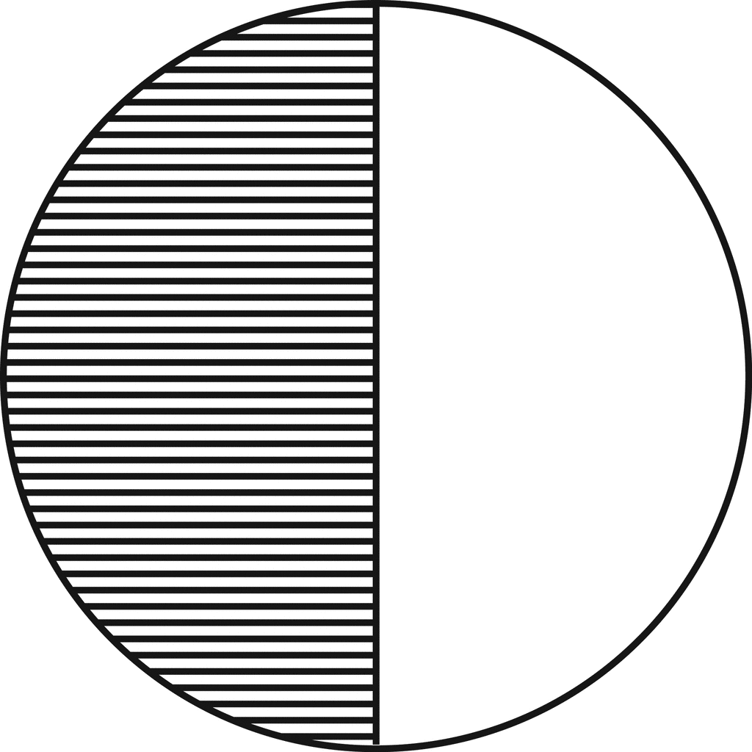
EQ: How do I convert between decimals to percentages.
Fractions, decimals and percentages are just three ways of representing the same amount.
0.5
½
This is what we are going to be focussing on today.
50%

Slide 5
EQ: How do I convert between decimals to percentages.
Examples
0.5
50%
What do we think the rule might be for converting between decimals to fractions?
Do you think this rule will always work?
What do you think 0.6 is as a percentage?
Were you correct?
0.6
60%
What about 0.35 is as a percentage?
Were you correct?
0.35
35%
X 100
So the rule is………

Slide 6
EQ: How do I convert between decimals to percentages.
Hinge Questions
DECIMALS
PERCENTAGES
0.23 =
0.8 =
0.56 =
0.231 =
23%
X 100
80%
56%
23.1%

Slide 7
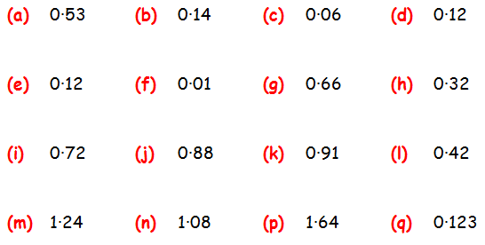
EQ: How do I convert between decimals to percentages.
Fluency and Understanding

Slide 8
EQ: How do I convert between decimals to percentages.
Answers
53%
14%
6%
12%
12%
1%
66%
32%
72%
88%
91%
42%
124%
108%
164%
12.3%

Slide 9
EQ: How do I convert between decimals to percentages.
Fluency and Understanding
1. | Convert the following decimals into percentages
A | 0.68 | D | 0.7 | G | 0.125
B | 0.16 | E | 0.9 | H | 0.175
C | 0.06 | F | 0.41 | I | 0.003
2. | Convert the following percentages into decimals
A | 80% | D | 18% | G | 0.3%
B | 43% | E | 94% | H | 6%
C | 1% | F | 35.6% | I | 100%
Decimals
Percentages

Slide 10


EQ: How do I convert between decimals to percentages.
Fluency and Understanding
https://play.kahoot.it/#/?quizId=96e50f6f-c2ed-42f3-a8e1-284cb586deaa
https://quizizz.com/admin/quiz/start_new/5a9dbb41117ca40019b94e49

Slide 11


EQ: How do I convert between decimals to percentages.
Connections and reasoning
At a cinema, 0.4 of the audience are adults. The rest of the audience is made up of boys and girls. There are twice as many girls as boys.
What percentage of the audience are girls?
Three children have each read 360 pages of their own book. Kenny’s book has 500 pages.
Lenny’s book has 400 pages.
Penny’s book has 600 pages.
How much of their books have they each read as a decimal?
Who has read the most of their book?

Slide 12
EQ: How do I convert between decimals to percentages.
Answers
At a cinema, 0.4 of the audience are adults. The rest of the audience is made up of boys and girls. There are twice as many girls as boys.
What percentage of the audience are girls?
40% are adults
60% are children
So 40% of the audience is girls as 20% are boys which makes the 60% which are children
Three children have each read 360 pages of their own book. Kenny’s book has 500 pages.
Lenny’s book has 400 pages.
Penny’s book has 600 pages.
How much of their books have they each read as a decimal?
Who has read the most of their book?
Kenny has read 72% or 0.72
Lenny has read 90% or 0.9
Penny has read 60% or 0.6
Lenny has read the most of his book.

Slide 13
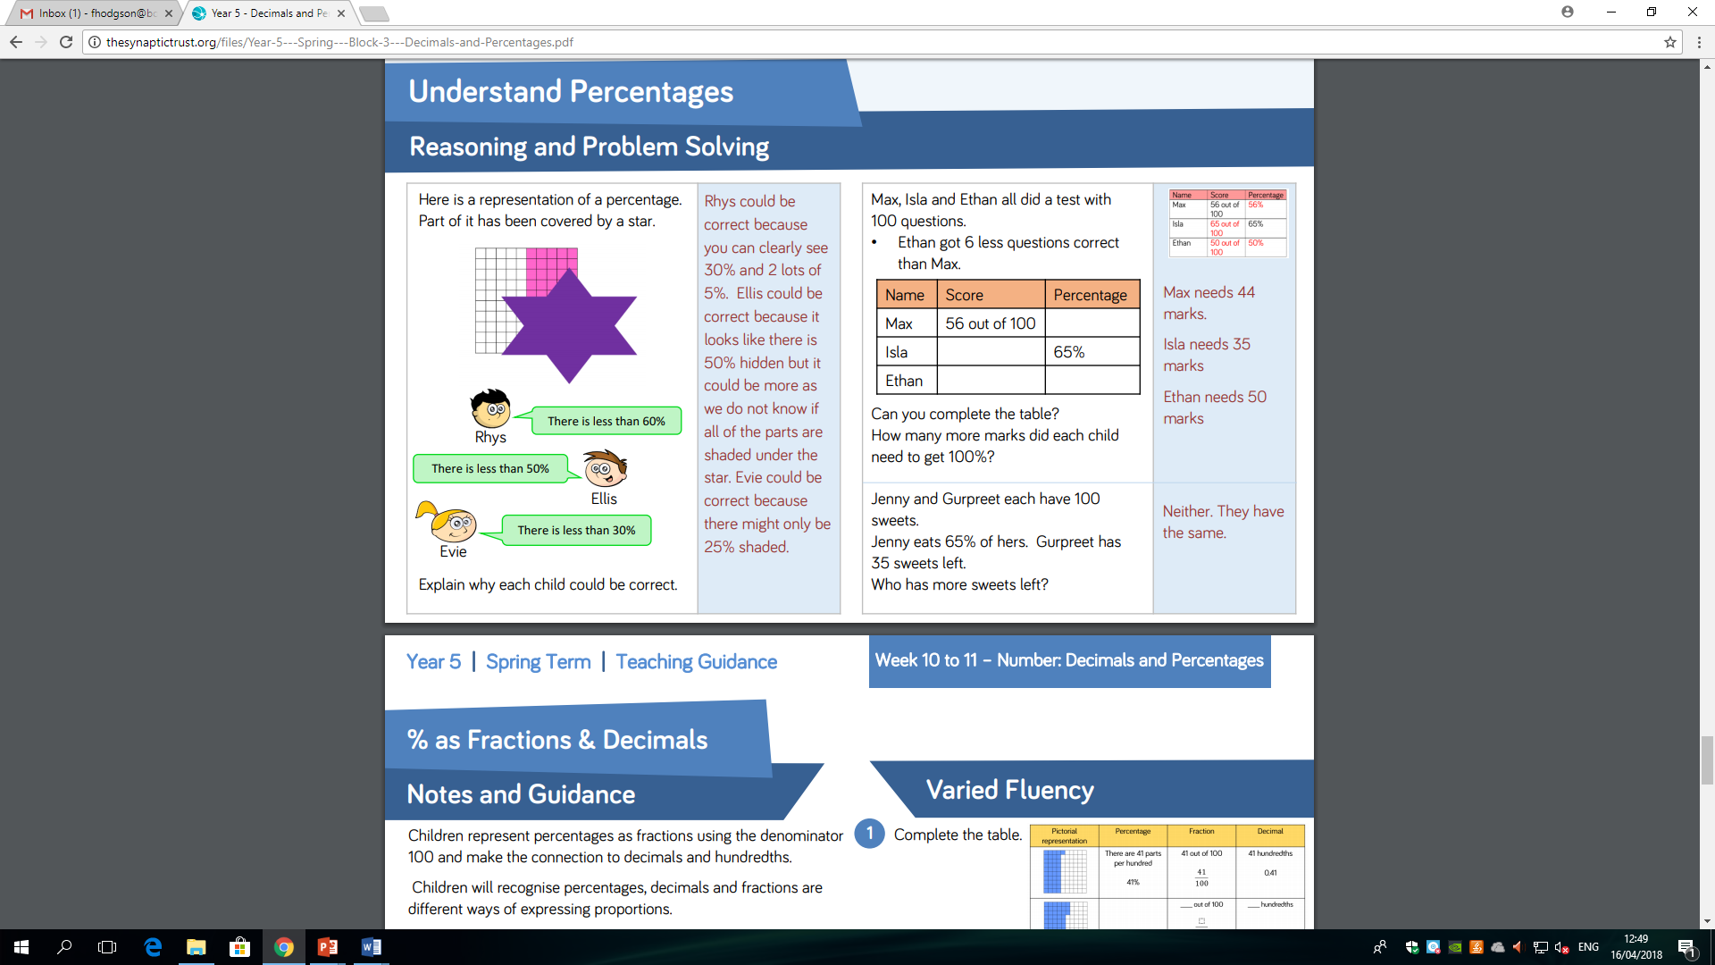
EQ: How do I convert between decimals to percentages.
Problem solving

